Slide 1
Blood Findr
Lord Caguiat
Enrico Gloria
Vince Nato
Sean Magalong

Slide 2
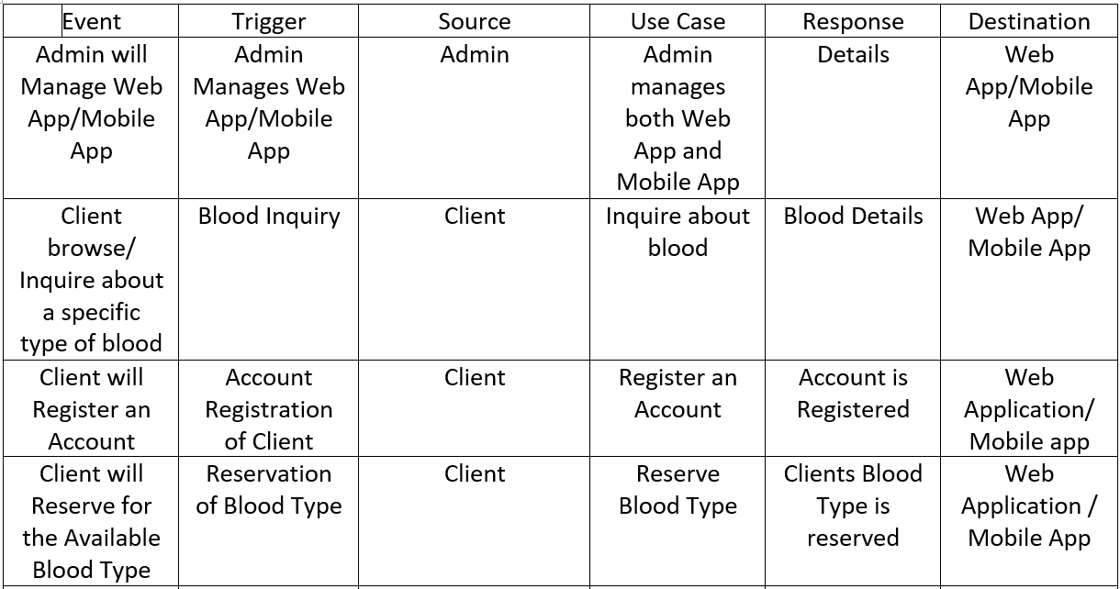
Event Table:

Slide 3
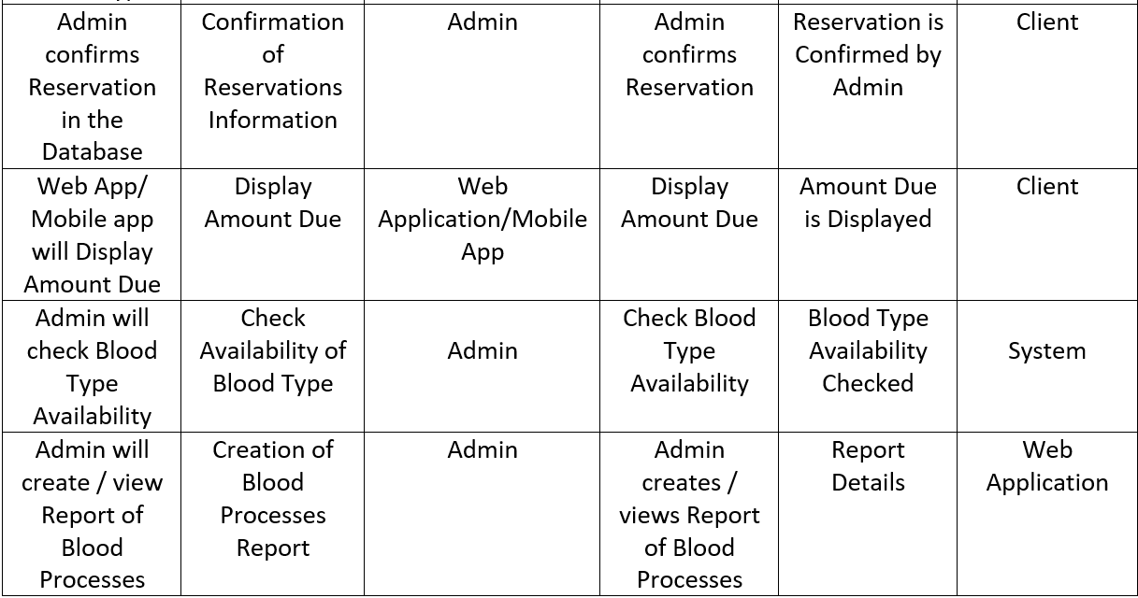
Event Table (cont.):

Slide 4
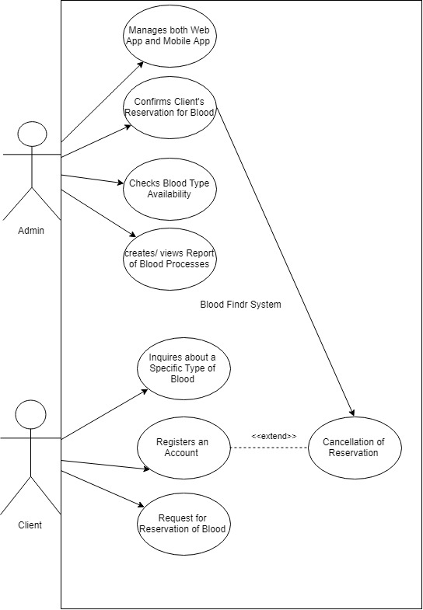
Use Case Diagram:

Slide 5
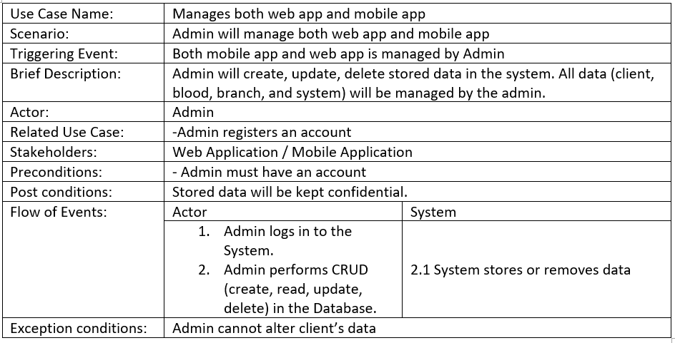
Use Case Full Description:

Slide 6
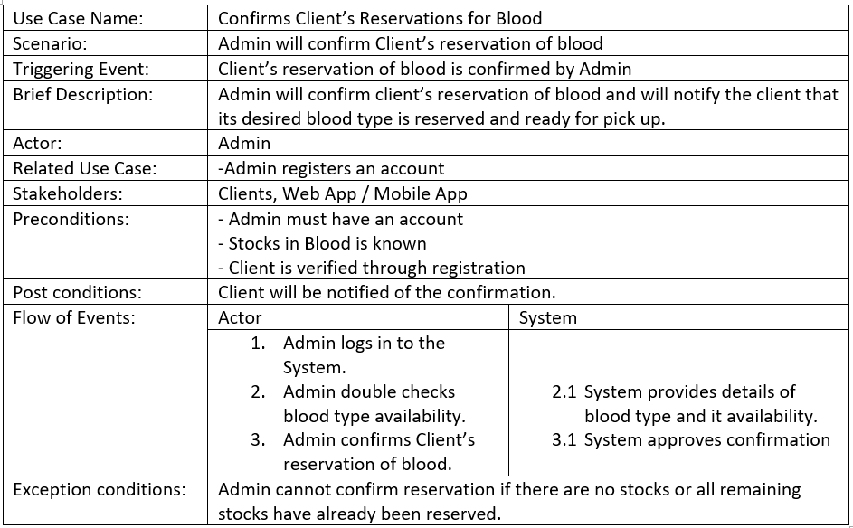
Use Case Full Description (cont.):

Slide 7
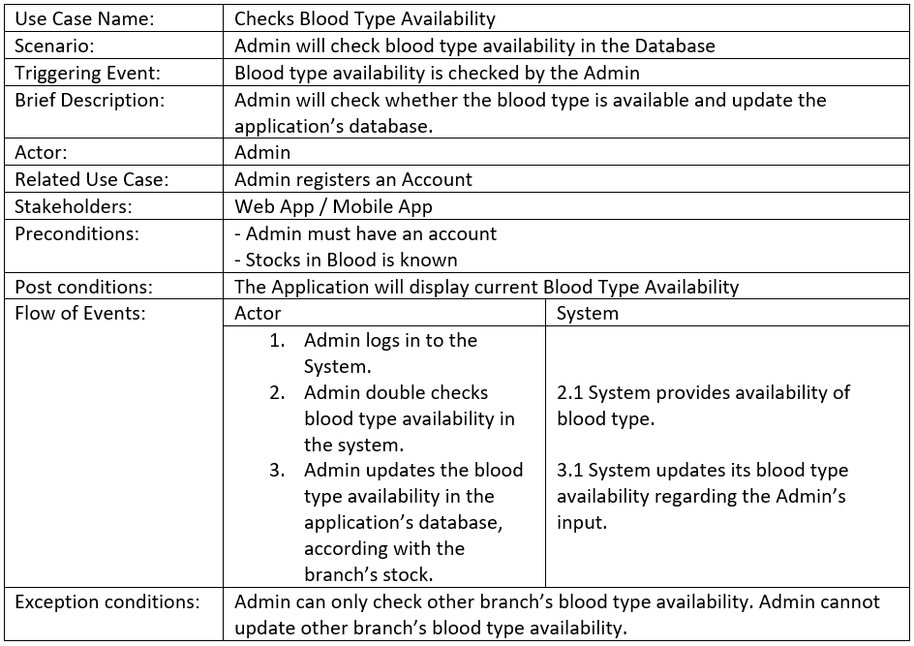
Use Case Full Description (cont.):

Slide 8
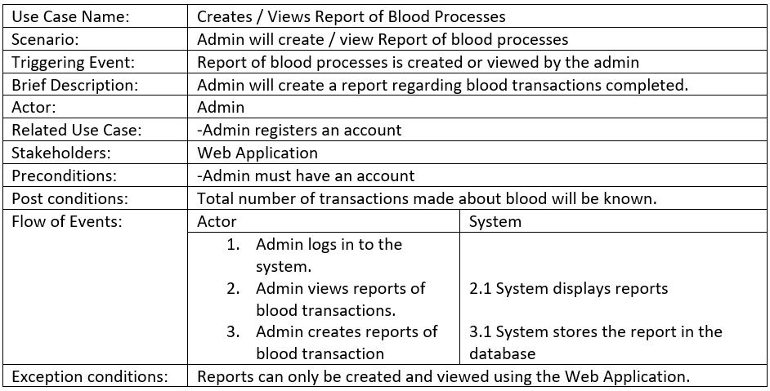
Use Case Full Description (cont.):

Slide 9
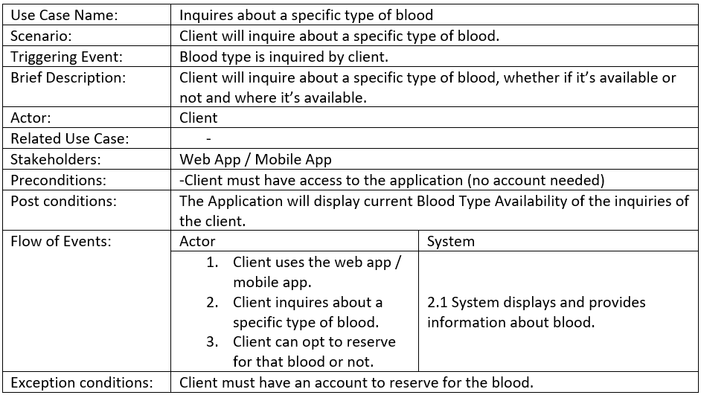
Use Case Full Description (cont.):

Slide 10
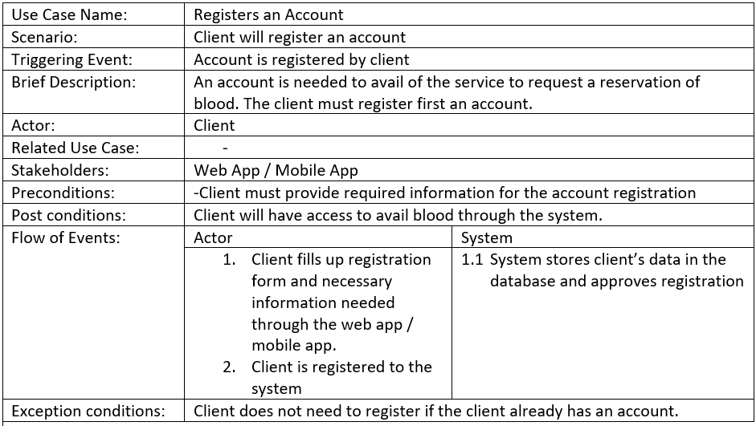
Use Case Full Description (cont.):

Slide 11
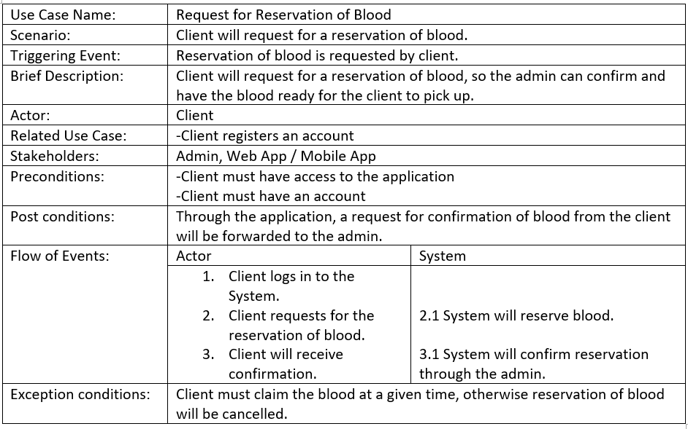
Use Case Full Description (cont.):

Slide 12
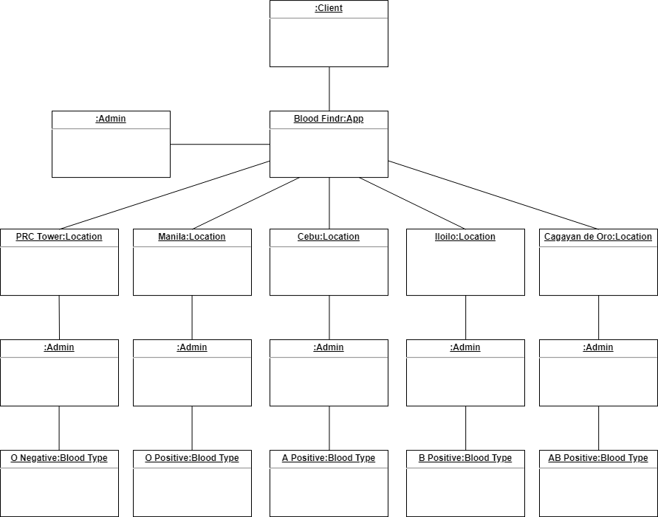
Object Diagram:

Slide 13
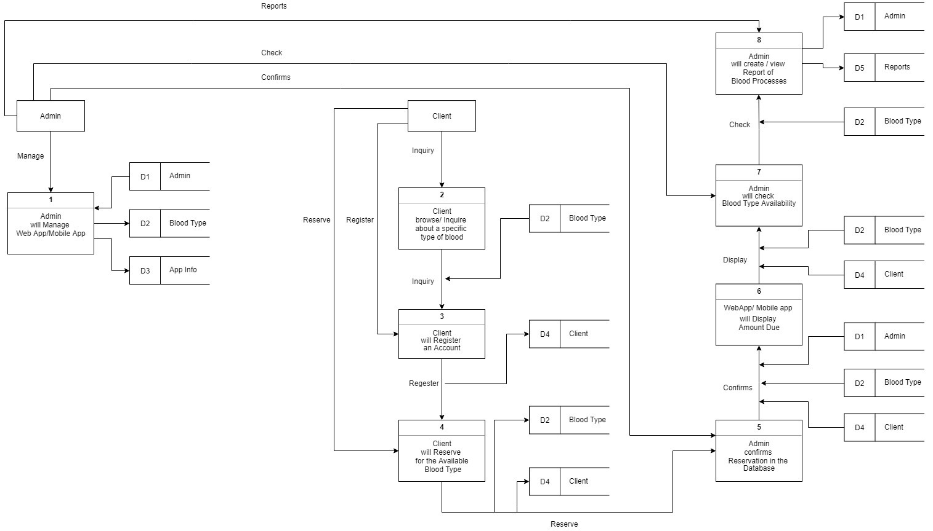
Data Flow
Diagram:

Slide 14
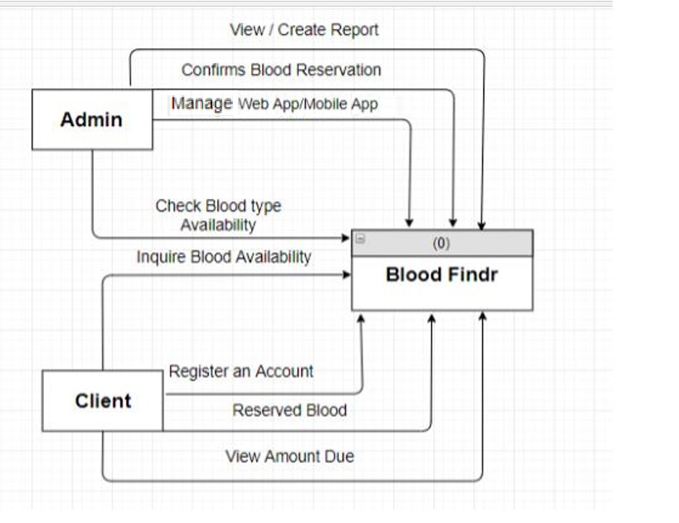
Context Flow
Diagram:

Slide 15
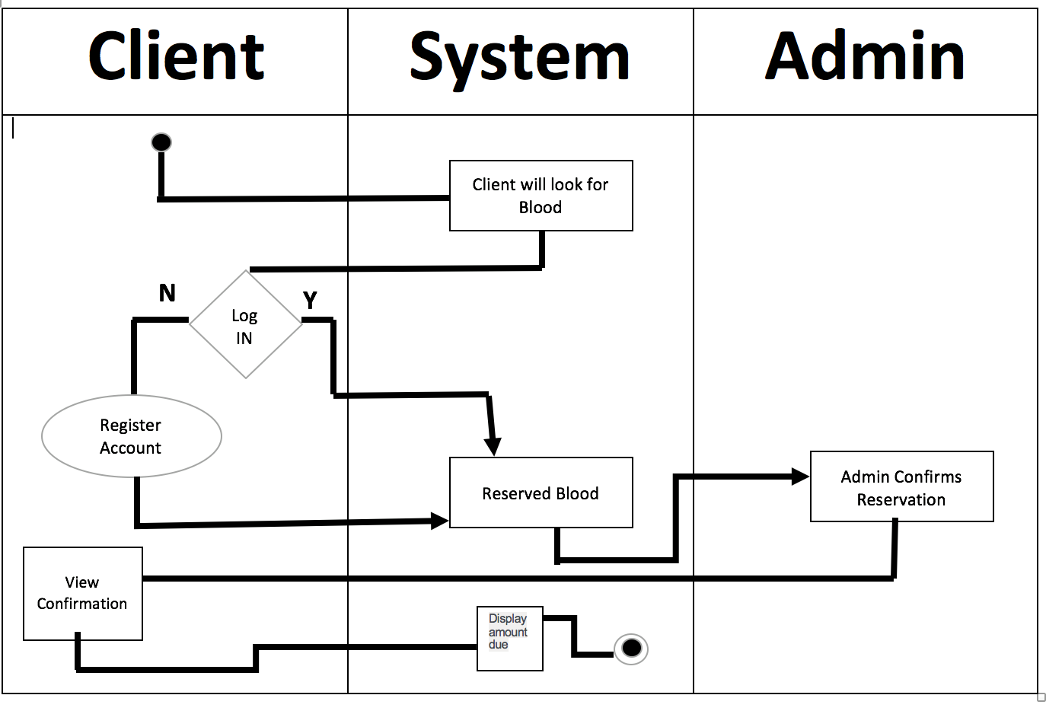
Activity Diagram:

Slide 16
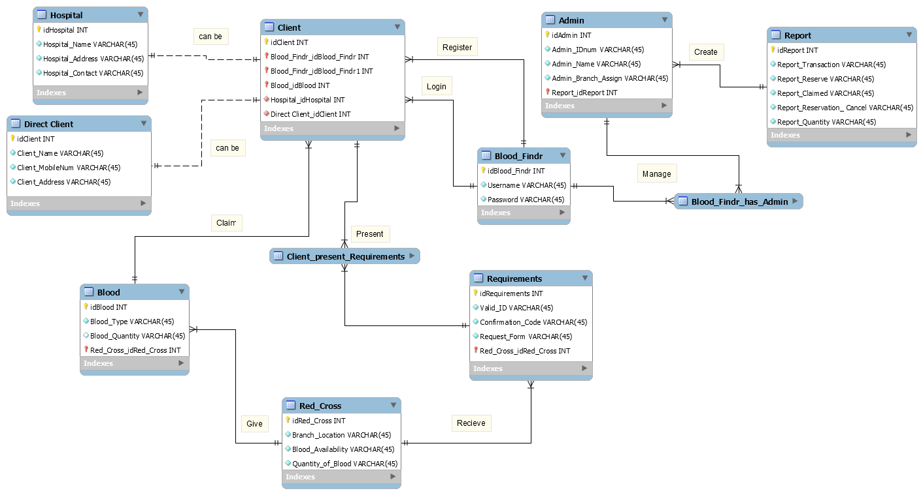
Entity Relationship Diagram:

Slide 17
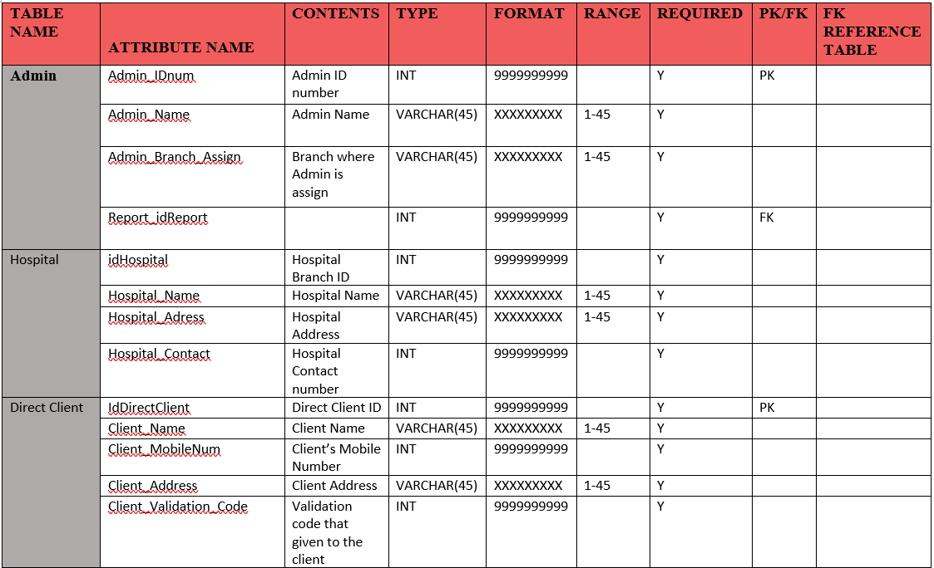
Data Dictionary:

Slide 18
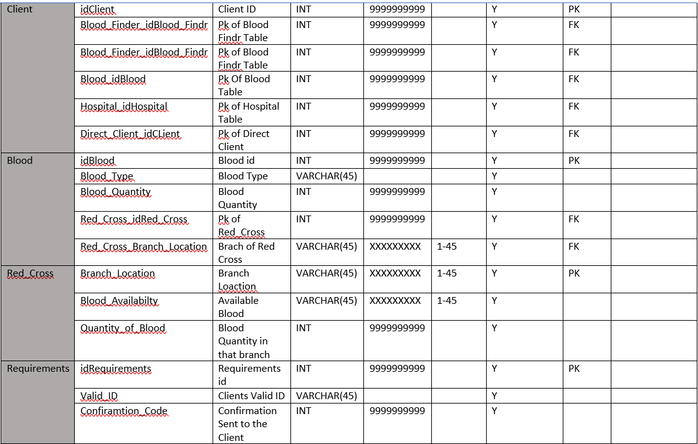
Data Dictionary (cont.):

Slide 19
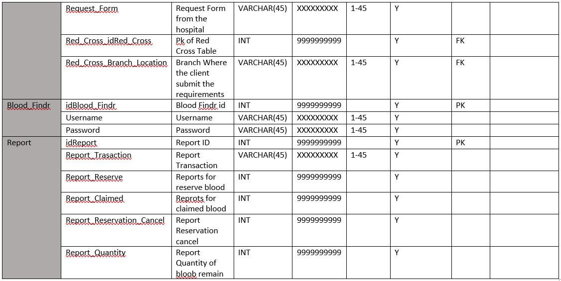
Data Dictionary (cont.):

Slide 20
Class Diagram:

Slide 21
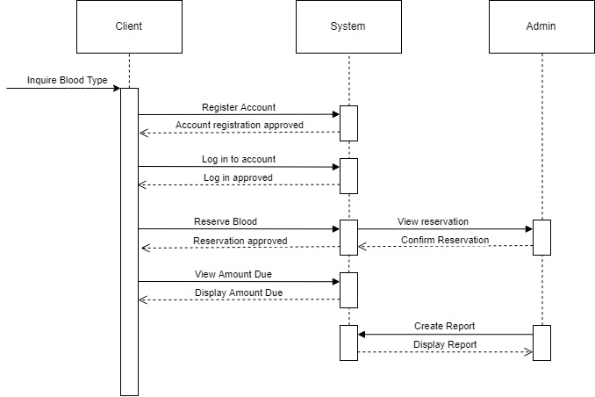
Sequence Diagram:

Slide 22
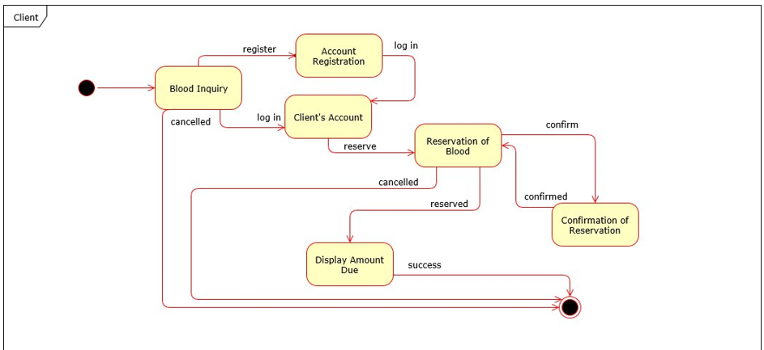
State Machine Diagram (Client):

Slide 23
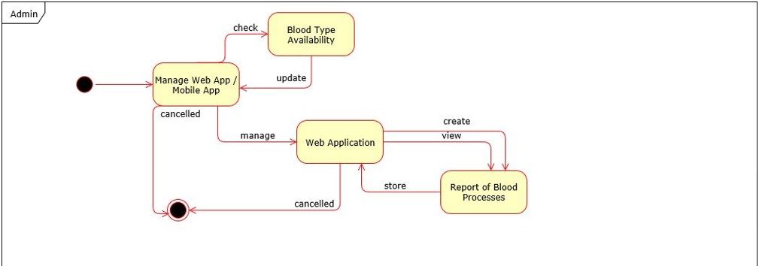
State Machine Diagram (Admin):

